Slide 1
Reaction dynamics with neutron and proton halo beams Alessia Di Pietro

Slide 2
Outline
Interplay between reaction and structure
Peculiarities in the structure of light exotic nuclei
Skin
Halo
Clusters
Structure effects on reaction dynamics
Highlights of results with n-halo beams
Preliminary results of ¹¹Li+⁶⁴Zn @ TRIUMF
The p-halo induced reaction ⁸B+⁶⁴Zn @ HIE-ISOLDE
Conclusions

Slide 3
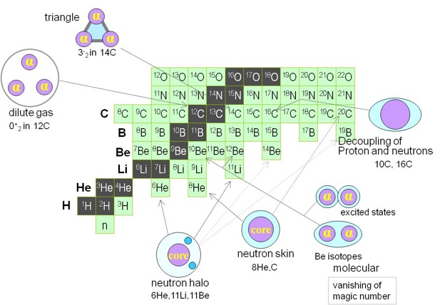
The special case of light nuclei
From Kanada-En’yo
Light nuclei: a quantum mechanics laboratory
Quantum mechanics plays a role in creating peculiar structures in ground states of light nuclei: nuclear skins and/or nuclear halos, nuclear clusters, nuclear molecules, gas condensate ….
Experimental challenge—> low intensity beams
Theoretical challenge → extension models needs to be made which properly describe the nuclear structure

Slide 4

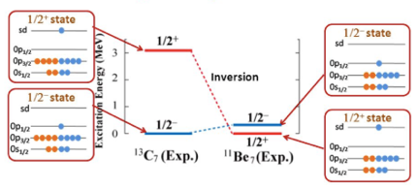
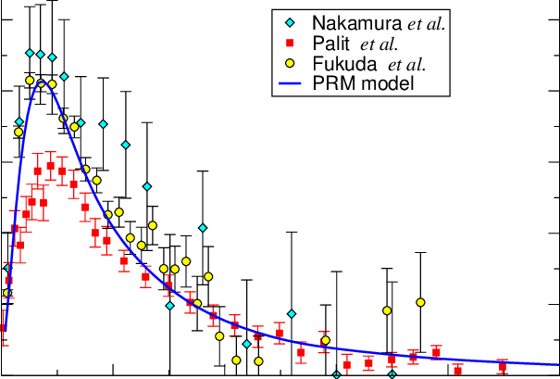
¹¹Be case:
Extremely large radius
W.Nortershäuser et al. PRL 102, 062503 (2009)
Parity inversion of g.s. and 1st excited state
Strongest known electric dipole transition between bound states in nuclei
B(E1)=0.102(2)e²fm²
Large non-resonant dipolar strength above threshold
B(E1) distribution

Slide 5
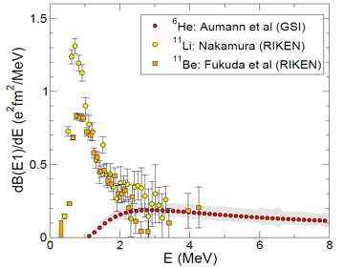
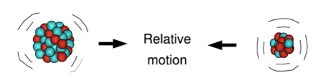
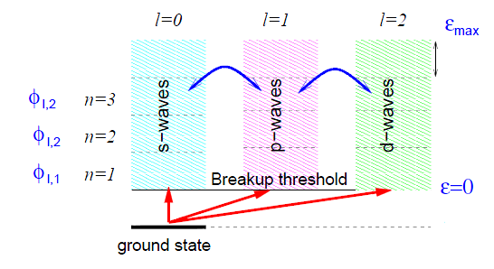
How Nuclear Halo influences reactions?
The n-halo case: e.g. ¹¹Li, ¹¹Be, ⁶He
Weakly bound (easy to break-up)
Easy to polarise (large B(E1) low energy strenght)
Suffer lower Coulomb barrier
Higher transfer cross-section?
B(E1) distribution
T. Nakamura et al., Phys. Rev. Lett. 96, 252502 (2006).
T. Aumann et al., Phys. Rev. C 59, 1252 (1999).
N. Fukuda et al., Phys. Rev. C70, 054606 (2004).
Coupling between relative motion and intrinsic excitation relevant at low energy.
g.s. close to the continuum → important to include coupling to the continuum in reaction dynamics –> CDCC
A. Di Pietro et al. to be published

Slide 6
Elastic Scattering

Slide 7
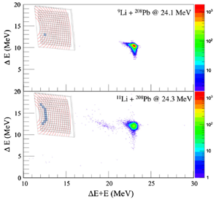
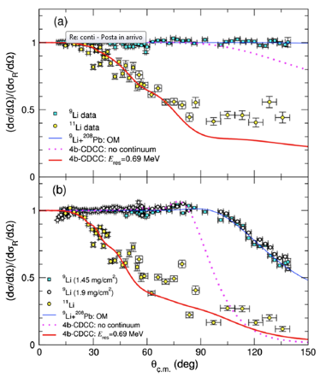
¹¹Li+²⁰⁸Pb
Suppression of elastic cross-section due to strong Coulomb coupling to the dipole states in the low-lying continuum of ¹¹Li.
Calculations suggest the presence of a low-lying dipole resonance in ¹¹Li close to the breakup threshold.
M.Cubero et al.,Phys. Rev. Lett. 109, 262701 (2012)

Slide 8

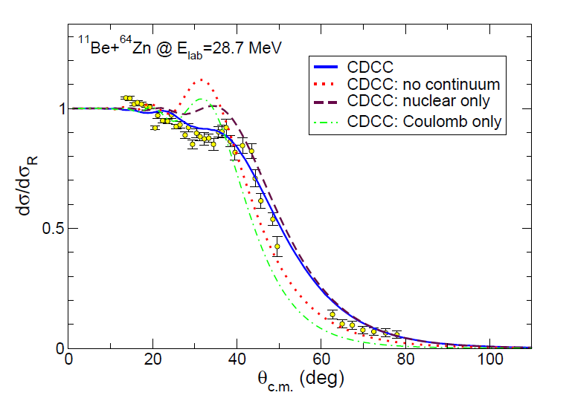

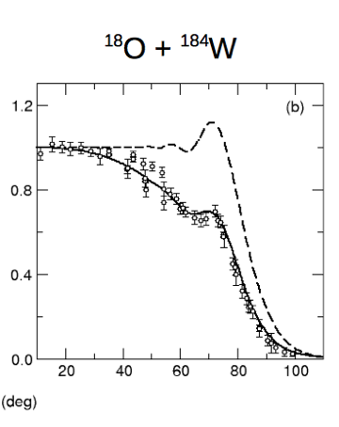

¹¹Be+⁶⁴Zn
quasi-elastic angular distribution
Both Coulomb and nuclear break-up important
¹¹Be
A. Di Pietro et al. Phys. Rev. Lett. 105, 022701(2010)
A. Di Pietro et al. Phys. Rev. C 85, 054607 (2012)
Long-range absorption

Slide 9
In the case of a halo nucleus with a deformed core dynamic excitation of the core may occour.
))
h
C
h
))
C
T
CDCC accounts of halo degrees of freedom
XCDCC accounts for both the halo and core degrees of freedom.
Core-excitation effects in 2n-halo nuclei (e.g.¹¹Li) far from being calculable!

Slide 10
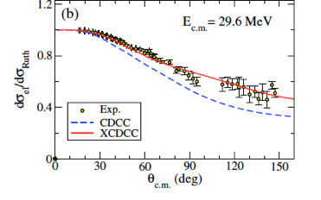
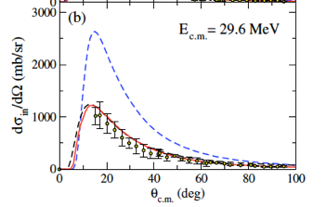
The importance of core-excitation
¹¹Be+¹⁹⁷Au @ TRIUMF
Elastic scattering
¹¹Be*_{1/2-}+¹⁹⁷Au
V. Pesudo et al. Phys. Rev. Lett. 118, 152502 (2017)
CDCC accounts of halo degrees of freedom. Coupling to continuum effects insufficient to reproduce the experimental data.
XCDCC accounts for both the halo and core degrees of freedom.
The structure model accounts for the appropriate admixture of 0+ and 2+ components in the ¹⁰Be core.
))
h
C
))

Slide 11
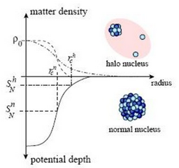
Collective
Dipole Resonances
from ANL.GOV
Halo-induced large enhancement of soft dipole excitation of ¹¹Li
J. Tanaka et al.Phys. Lett. B774(2017)268
Notes:
Isoscalar dipole resonanace Ex+0.8 MeV strenght 30-300 Wu 2-20% sum rule. It originates from halo and consistent with dineutron model of 11Li.

Slide 12
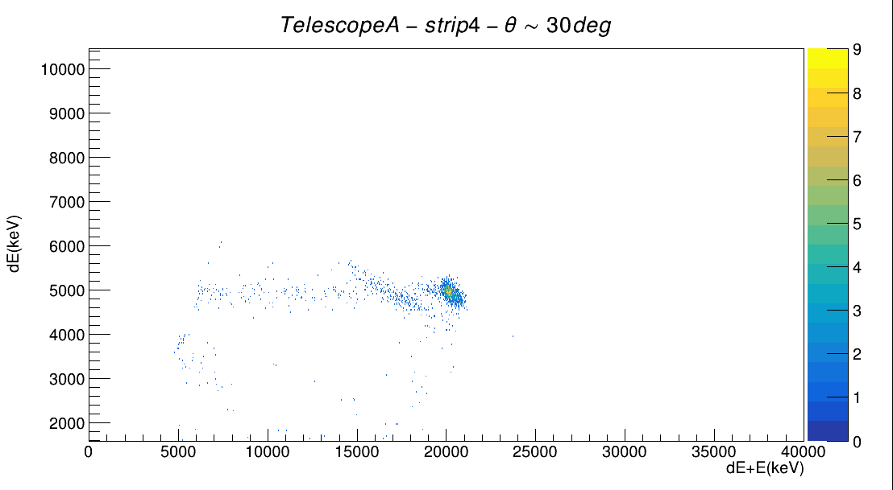
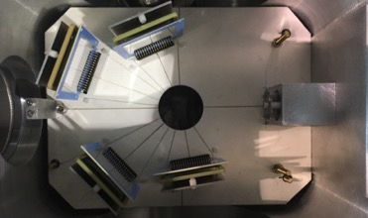
¹¹Li+ ⁶⁴Zn @TRIUMF
¹¹Li beam
⁹Li
¹¹Li
target
Large suppression of the Coulomb-nuclear interference peak.
J.P. Fernandez et al. Phys. Rev.C 99, 054605 2019
A. Di Pietro et al. Phys. Rev. Lett. 105, 022701(2010)

Slide 13
¹¹Li+⁶⁴Zn breakup probability
⁹Li
¹¹Li

Slide 14
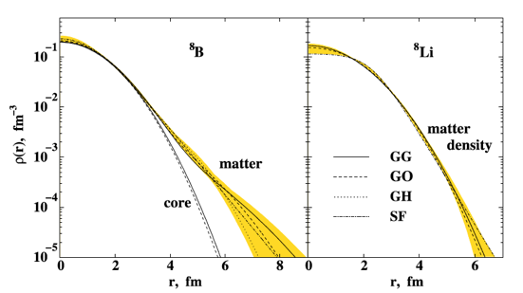
p
⁸B extremely low binding energy
Sp=0.14 MeV
p-wave valence proton
⁷Be
⁸B vs ⁸Li density distribution
G.A. Korolev et al. Phys.Lett. B 780 (2018) 200

Slide 15
p-halo vs n-halo induced collisions
● p in the halo feels Coulomb interaction, expected dynamics different from n-halo
(e.g. Kucuc&Moro PRC86,034601,(2012) or A.Bonaccorso et al.: PRC69,024615,(2004)).
Possible semiclassical picture
T
T
n
C
C
p
Due to a dynamic polarization effect, the valence proton is expected to be displaced behind the nuclear core and shielded from the target; this effect causes a reduction of break-up probability compared to first-order perturbation theory predictions
Notes:
in fact, the loosely bound valence proton actively participates in the
reaction process. Due to a dynamic polarization effect, the valence proton is expected to be displaced
behind the nuclear core and shielded from the target; this effect causes a reduction of break-up
probability compared to first-order perturbation theory predictions and higher-order corrections are
required [e.g. (A. Garcìa-Camacho et al. ) (J.F. Liang et al.)]. As discussed in [ (C. Dasso et al. )]
nuclear processes are expected to have a primary role in the dissociation of 8B. This has been
experimentally observed in e.g. 8B+208Pb at 142 A MeV where it was found that the nuclear break-up
accounts for about half of the total break-up cross-section [ (B. Blank et al.)]. Conversely for the n-halo
nucleus 11Be on the same target at a similar energy the Coulomb contribution far exceeds the nuclear
one [ (A. Bonaccorso et al. )]. Contrary to the n-halo, in the case of p-halo the Coulomb interaction
acts not only between the core and the target but also between the p and the core and the p and the
target. In [ (A. Bonaccorso et al. )] the role of the p–core and p-target interaction in the p-halo break-up
was studied theoretically. The effect of these additional potentials is to create an effective barrier,
which makes the proton of the halo effectively more bound.

Slide 16
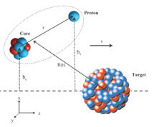
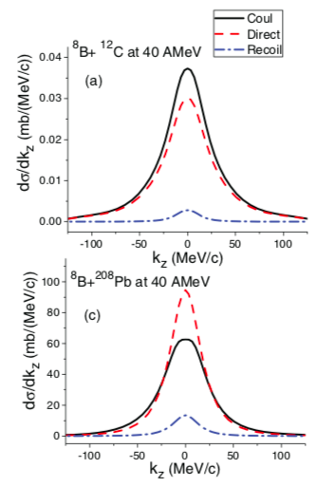
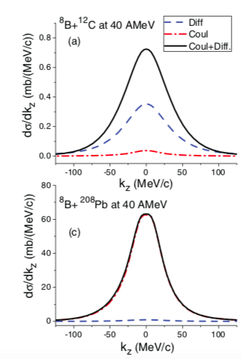
Coulomb
Coulomb+nuclear
Direct
Recoil
R. Kumar and A. Bonaccorso Phys. Rev. C.86.061601.2012
Notes:
the effect of the core-target Coulomb potential (called the recoil effect), with respect to which the proton behaves again as a more bound neutron, from the (direct) proton-target Coulomb potential effect. The latter gave cross sections about an order of magnitude larger than the recoil term.
The semiclassical method used allows us to treat both the full nuclear and Coulomb interactions to all orders and all multipolarities. On a light target the total nuclear breakup is always larger than the Coulomb breakup. On the other hand although the Coulomb breakup is very small the interference between diffraction and Coulomb is constructive and such that the total becomes quite large. On a heavy target instead the total nuclear breakup is of the same order of magnitude as the Coulomb recoil effect while the direct Coulomb breakup is one order of magnitude larger. Thus this term dominates not only in the total Coulomb breakup but also in the total diffraction plus Coulomb term. The quantitative assessment of the direct Coulomb breakup and of its interference with other mechanisms is very important

Slide 17
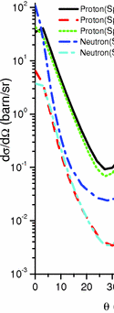
⁸B+²⁰⁸Pb @ 72AMeV p angular distribution
Direct
Recoil
The core-target Coulomb effect is basically a recoil effect for which the difference between a neutron and a proton is that the proton looks “more effectively” bound. The same is found for the nuclear breakup contribution.
R. Kumar and A. Bonaccorso Phys. Rev. C.84.014613, 2011

Slide 18
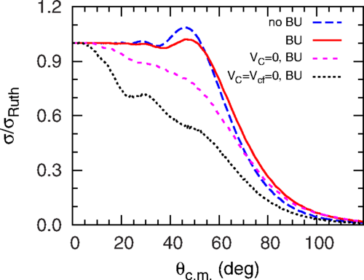
⁸B+⁶⁴Zn @ 32 MeV
⁸B+⁶⁴Zn CDCC calculations
The Coulomb and centrifugal barriers experienced by the valence proton in the ground state of ⁸B, which do not exist for the valence neutron in the ground state of ¹¹Be, are found to be the reason for the differences in the angular distributions
Y. Y. Yang, X. Liu, and D. Y. Pang
Phys. Rev. C 94, 034614, 2016

Slide 19
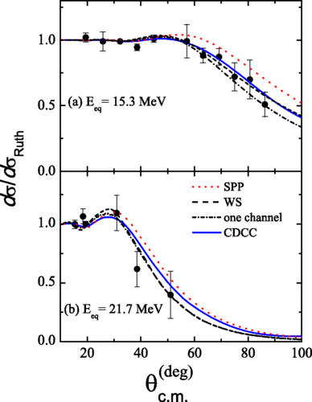
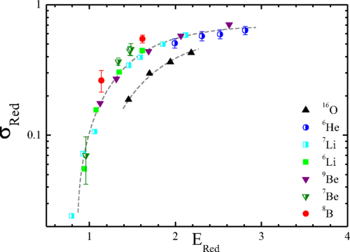
⁸B+²⁷Al @ 15,22 MeV
⁸B
V. Morcelle Phys. Rev. C 95 (2017)014615.

Slide 20
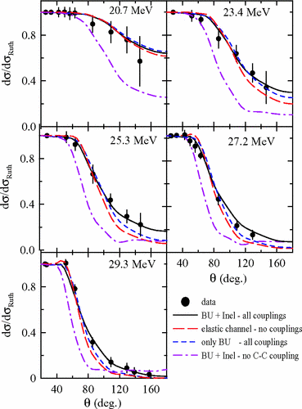
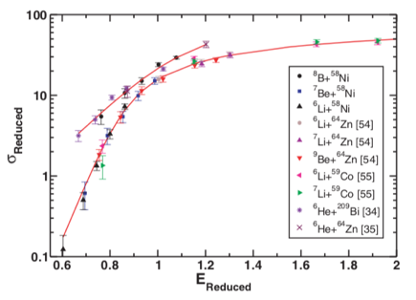
⁸B+⁵⁸Ni @ 20 - 30 MeV
⁸B
Small effects on elastic scattering however large total-reaction cross-section extracted from elastic data.
Found similar trend as for n-halo nuclei
J. Lubian et al Phys. Rev. C 79, 064605 (2009)
data from E.F. Aguilera et al. PR C 79, 021601(R) 2009
E. Aguilera et al. Phys. Rev. C 79 (2009) 021601
Notes:
The Coulomb and centrifugal barriers experienced by the valence proton in the ground state of 8B, which do not exist for the valence neutron in the ground state of 11Be, are found to be the reason for such differences in the angular distributions of elastic scattering cross sections of these two weakly bound nuclei.

Slide 21
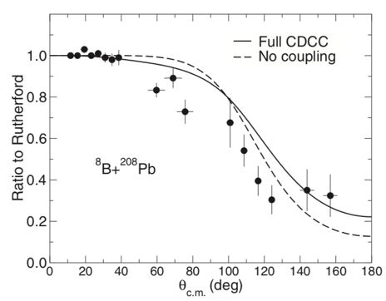
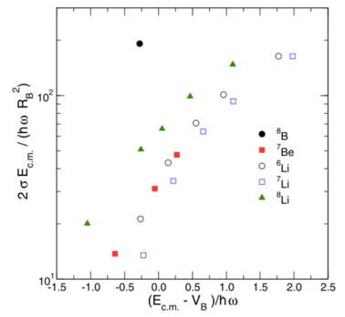
⁸B+²⁰⁸Pb @ 50 MeV
Elastic scattering
Systematic for total reaction cross section on ²⁰⁸Pb.
Large enhancement deduced in case of ⁸B.
⁸B
M. Mazzocco et al. PRC 100, 024602 (2019)

Slide 22
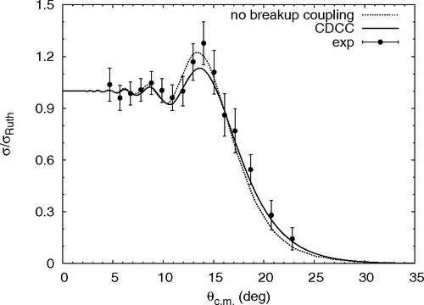
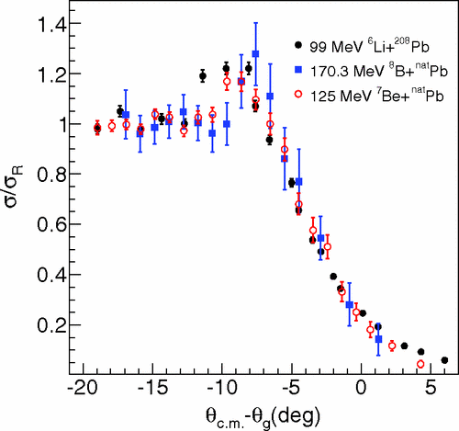
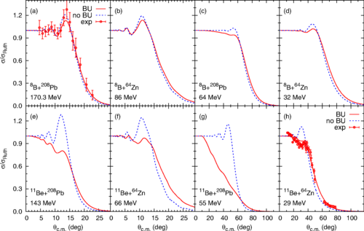
⁸B+²⁰⁸Pb@ RIBLL
Y. Y. Yang et al. Phys. Rev. C 87, 044613, 2013
⁸B
Calculations show independence on beam energy energy and target charge
¹¹Be
Y. Y. Yang, X. Liu, and D. Y. Pang
Phys. Rev. C 94, 034614, 2016

Slide 23

First ISOL ⁸B beam developed at HIE-ISOLDE for this experiment
⁸B+⁶⁴Zn @ 38.5 MeV
Beam purity > 99%
R. Spartà et al. Submitted to Phys. Lett. B
Total reaction cross-section for ⁸B+⁶⁴Zn σ_{R} ⩳1.5 b
similar to ⁹Be+⁶⁴Zn at similar E_{c.m.} / V_{c}

Slide 24
Breakup

Slide 25
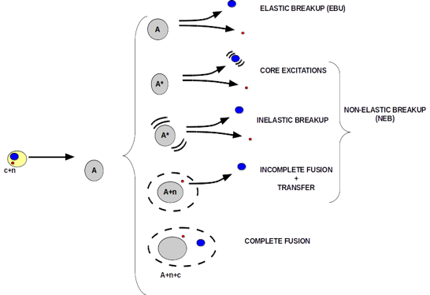
Break-up from inclusive data
CDCC provides EBU. How to compute NEB?
Re-examination of the inclusive breakup models proposed in the 80s
M. Ichimura, N. Austern, and C. M. Vincent, PRC 32, 431 (1985)
Based on participant-spectator picture
a(b+x)+A→b+B*
b =detected particle
B* = any possible final state of x+A
Jin Lei and A. M. Moro, Phys. Rev. C 92, 044616 (2015).
Notes:
La sezione d’urto d2s/dEbdWb-> rob(Eb) <psix|WxA|psix> rob =densita’ di stati della particella b WxA parte immaginaria del potenziale ottico x-A e psix descrive il moto relative x-A quando A e’ nello stato fondamentale e b scattera con momento kb. Psix calcolata con DWBA la funzione d’onda di a e’generate con I CDCC.

Slide 26
Inclusive break-up
¹¹Be+¹⁹⁷Au @ TRIUMF
Coulomb dominated break-up
V. Pesudo et al. Phys. Rev. Lett. 118, 152502 (2017)

Slide 27
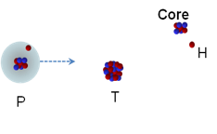
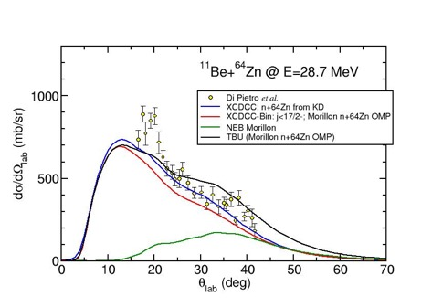
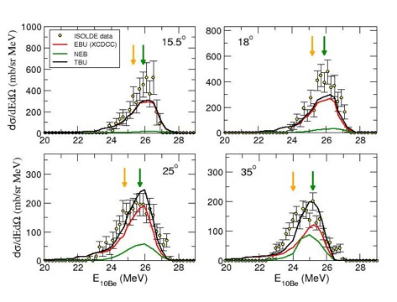
¹¹Be+⁶⁴Zn inclusive-breakup
Energy distributions
Elastic breakup is dominant
Non-elastic breakup important at larger angles
Small contribution from core-excitation
Post-acceleration observed
A. Di Pietro et al. Phy.Lett.B 798, 134954 (2019)
RTFNB 2019
Alessia Di Pietro,INFN-LNS

Slide 28
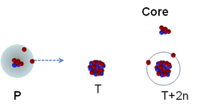
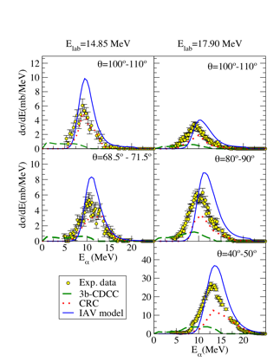
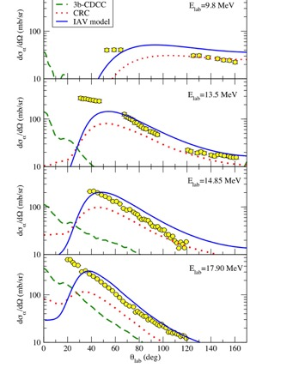
⁶He+⁶⁴Zn inclusive-breakup
Non-elastic breakup dominant.
2n transfer?
J.P. Fernandez et al. Phys. Rev.C 99, 054605 2019

Slide 29
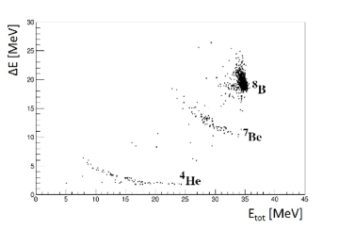
⁸B+⁶⁴Zn inclusive breakup
Direct breakup is the main machanism for the ⁷Be production.
Non-elastic breakup contributes at larger angles.
R.Sparta’ et al. submitted to Phys. Lett.B

Slide 30

The comparison of first order (DWBA) with all-orders (CDCC) calculations including only E1 Coulomb couplings confirms the expected deceleration effect suggesting a near-target breakup scenario; However, when higher Coulomb multipoles, as well as nuclear couplings, are considered no apparent acceleration or deceleration of the ⁷Be fragment with respect to the ⁸B c.m. motion.
R.Sparta’ et al. submitted to Phys. Lett.B

Slide 31
Fusion

Slide 32
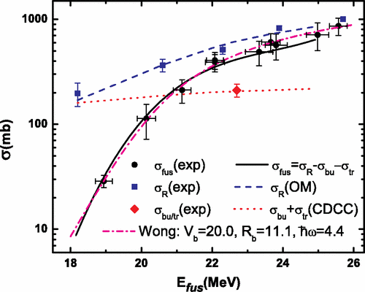
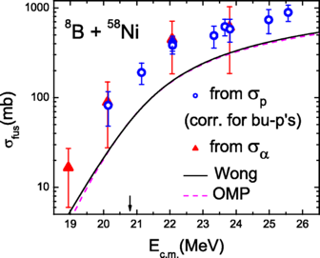
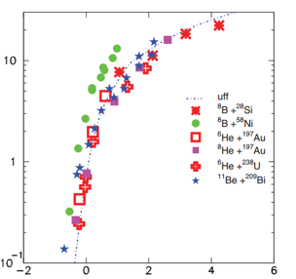
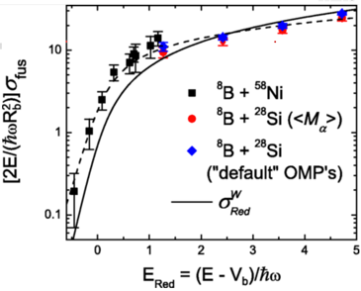
The p-halo case: ⁸B fusion
E.F. Aguilera et al, PRL107, 092701 (2011)
E.F. Aguilera et al, Phys. Rev. C 93, 034613, 2016
Systematics of fusion of n- and p- halo.
A.Pakou et al., PR C 87, 014619 (2013)
Reduced σ_{fus}
Reduced E

Slide 33
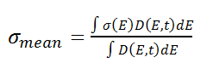
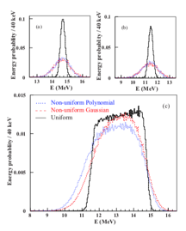
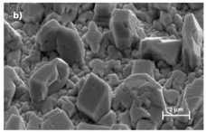
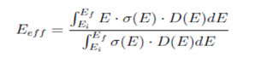
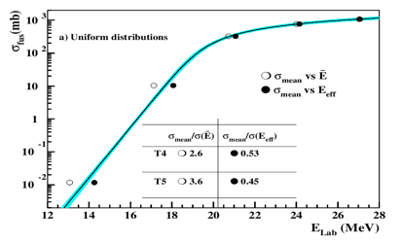
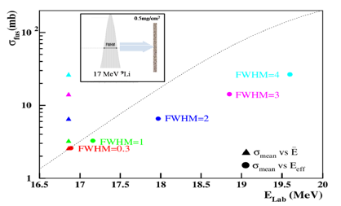
Fusion measurement with thick targets and/or low-resolution beams
Energy-loss in target
Is the target uniform?
E_{mean}=(E_{i}+E_{f})/2
Convoluted fusion excitation function
Effect of beam energy resolution
M. Fisichella et al. Phys.Rev. C 92, 064611 (2015)

Slide 34
⁸B+⁶⁴Zn @ ISOLDE
p - angular distribution
p - energy distribution
Preliminary
Sources of p besides fusion

Slide 35
⁸B+⁶⁴Zn @ ISOLDE
α - energy distribution
α - angular distribution
Preliminary
Other sources of α-particles
⁸B three-body breakup above the ³He+⁴He+p threshold (Ex=1.72 MeV)
IF of ³He, leaving the ⁵Li* which decays to ⁴He+p

Slide 36

E.F. Aguilera et al, Phys. Rev. C 93, 034613, 2016
⁸B+⁶⁴Zn
Preliminary

Slide 37
Conclusion
Light exotic nuclei exhibit many different structures .
Structural effects influence the reaction dynamic. This is particularly true in the case of halo nuclei. The experimental study of the dynamics of reaction induced by exotic nuclei has shown how it strongly depends on their structure:
n-halo nuclei
suppression of elastic cross-section
high inclusive breakup cross-section
P-halo nuclei
Similar behaviour as weakly bound stable nuclei
What need to be done:
Availability of higher intensity beam would allow more precise data and exclusive measurements.
Theory needs to accurately describe the nuclear structure and include in the reaction model. Some type of calculations still unfeasible (e.g. core excitation of 2n-halo nuclei)
Dynamic core excitation
Transfer
Incomplete fusion

Slide 38




